Slide 1

Big Data Platforms
Mihai Budiu
, Oct 6 2014

Slide 2

My work
Ph.D. from Carnegie Mellon, 2003
Hardware synthesis
Reconfigurable hardware
Compilers and computer architecture
Researcher at Microsoft Research Silicon Valley 2004-2014
Computer security
Cloud computing infrastructure:
distributed computation platforms
monitoring and debugging
performance analysis
Big data analysis and visualization
Large scale machine learning

Slide 3
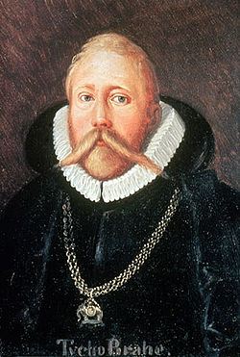
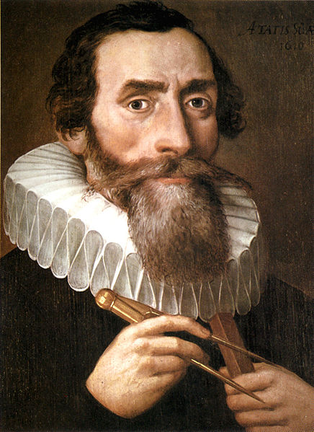
500 Years Ago
Tycho Brahe (1546-1601)
Johannes Kepler
(1571-1630)
Notes:
Images from Wikipedia

Slide 4
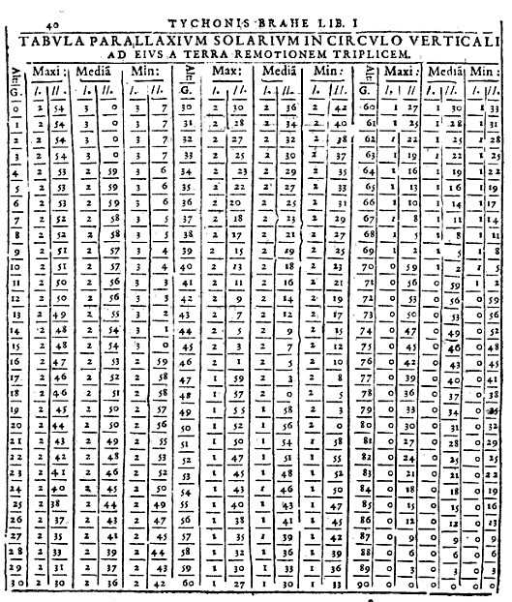
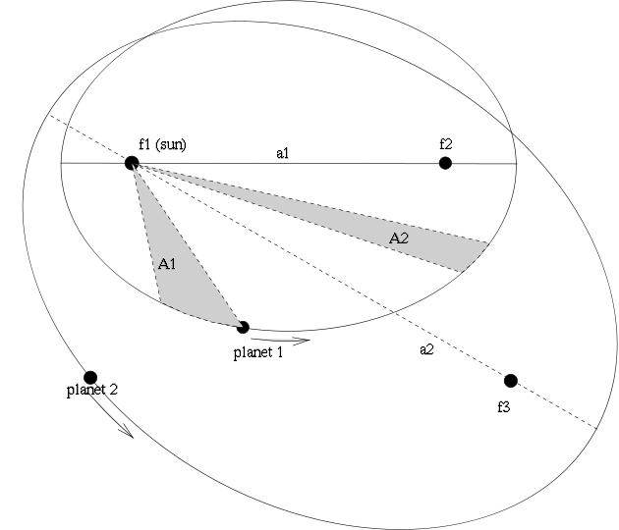
The Laws of Planetary Motion
Tycho’s measurements
Kepler’s laws
Notes:
Left image from Google Books.
Right image from Wikipedia.

Slide 5
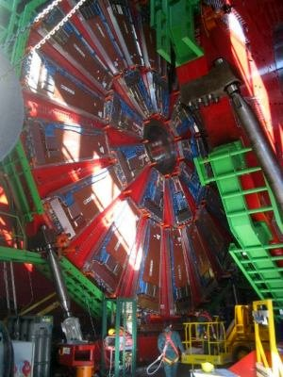
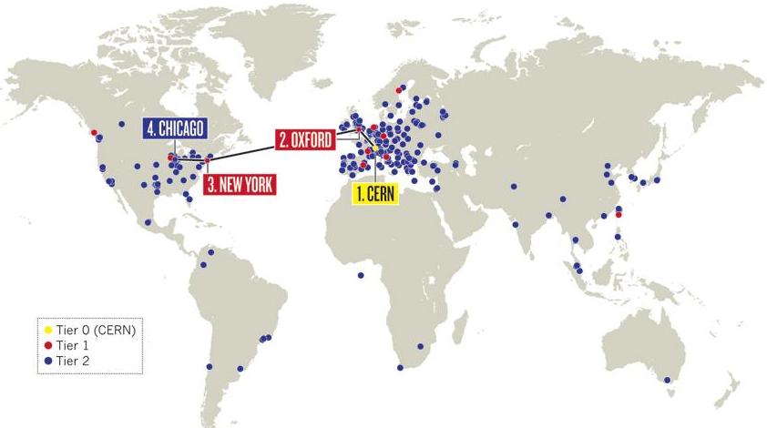
The Large Hadron Collider
WLHC Grid: 200K computing cores
25 PB/year
Notes:
Left image from Wikipedia.
Right image from Nature.com

Slide 6
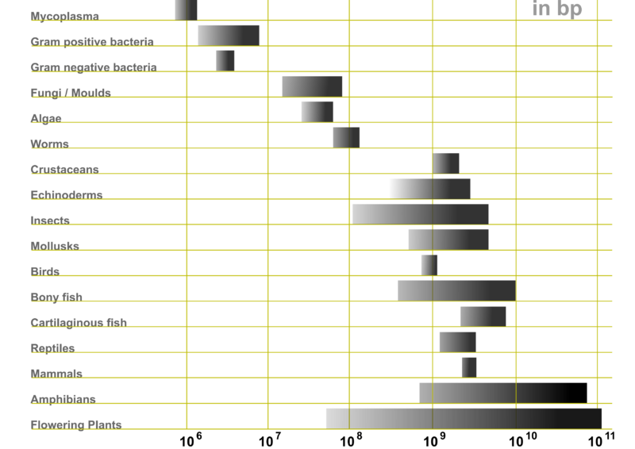
Genetic Code
Notes:
Image from Wikipedia

Slide 7
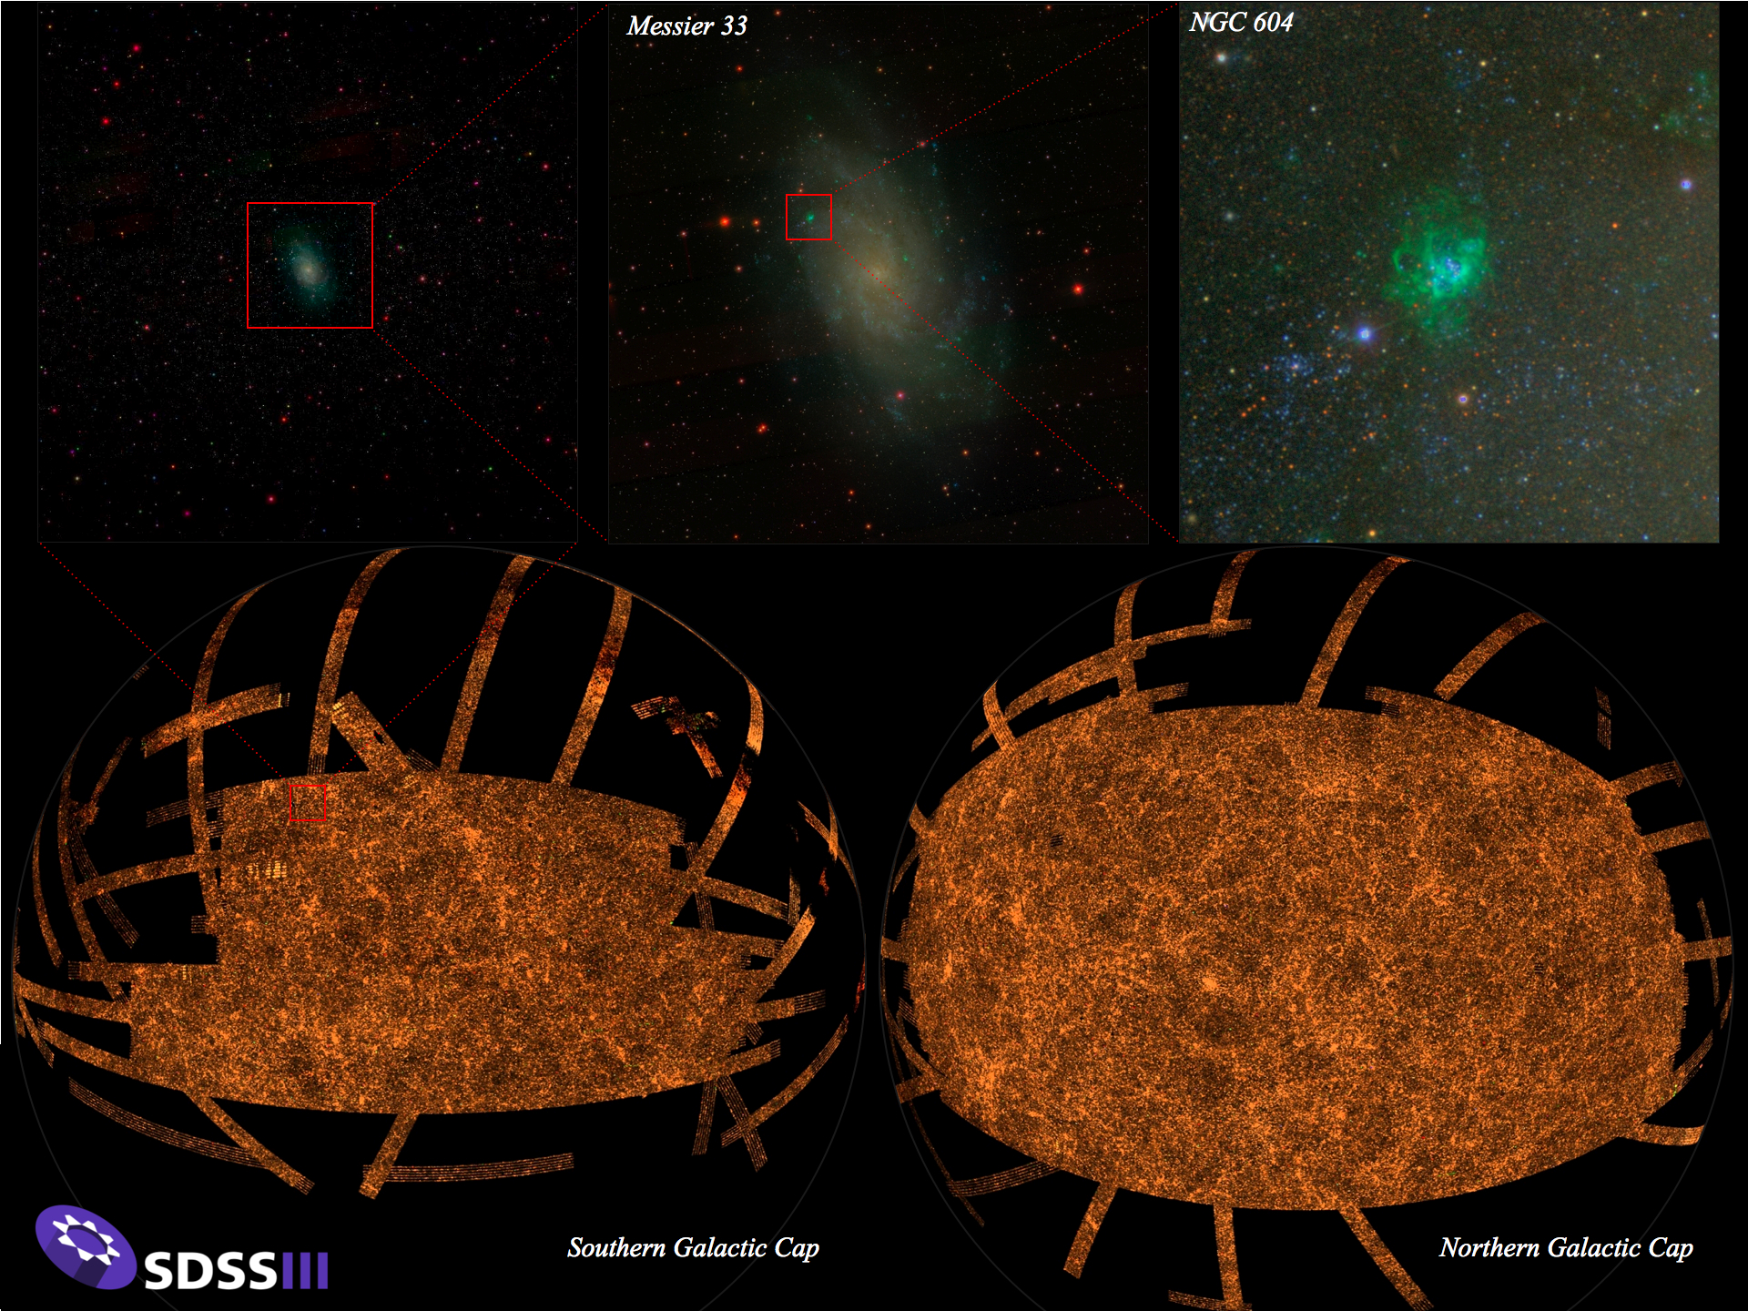
Astronomy
Notes:
Image from sdss3.org

Slide 8
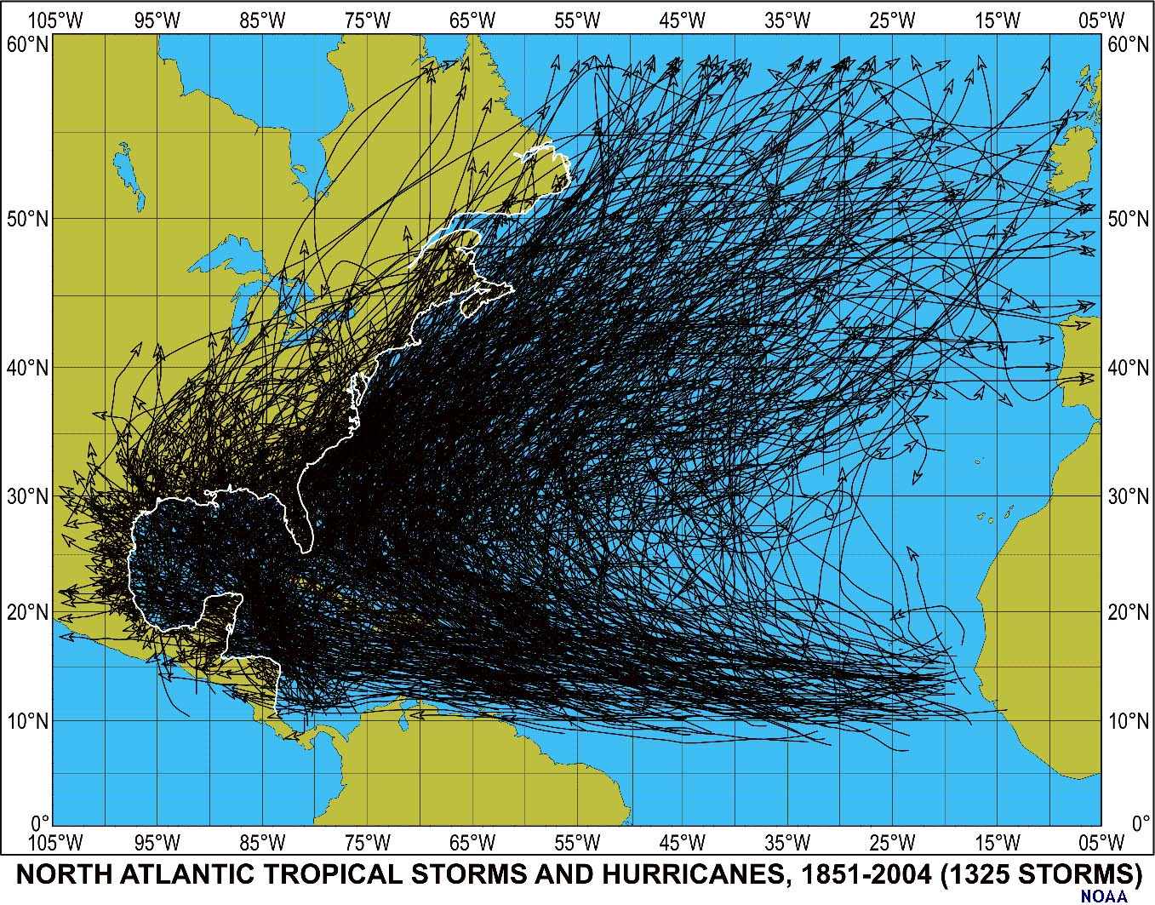
Weather
Notes:
Image from noaa.gov

Slide 9
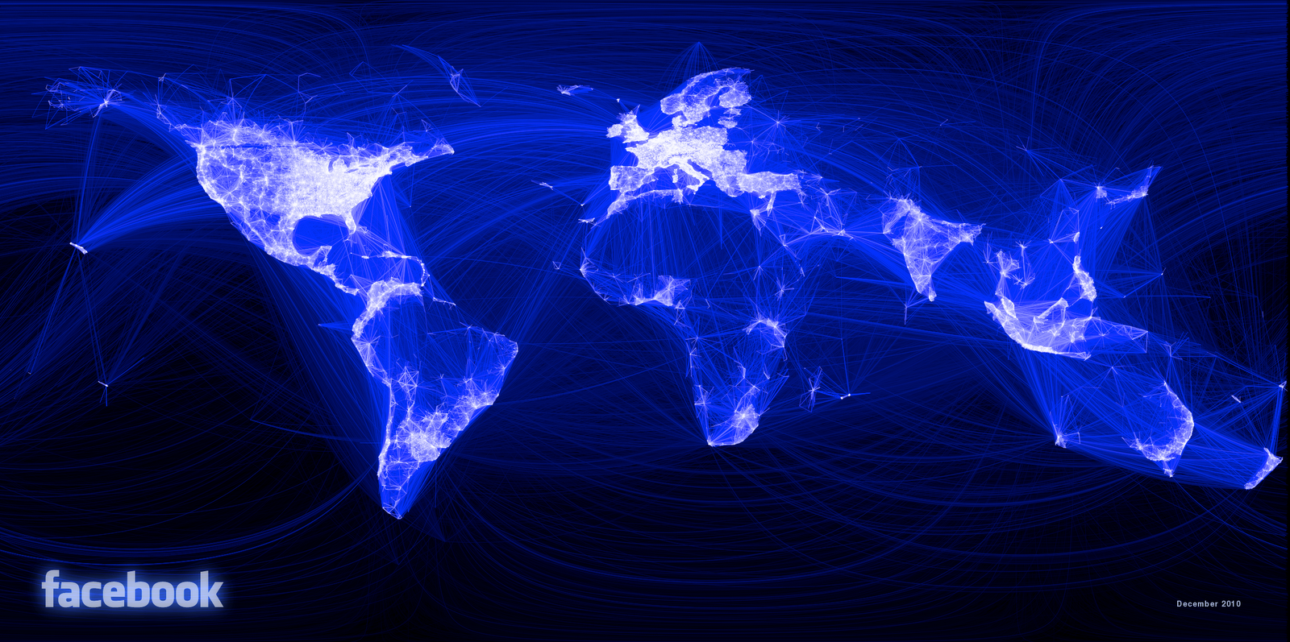
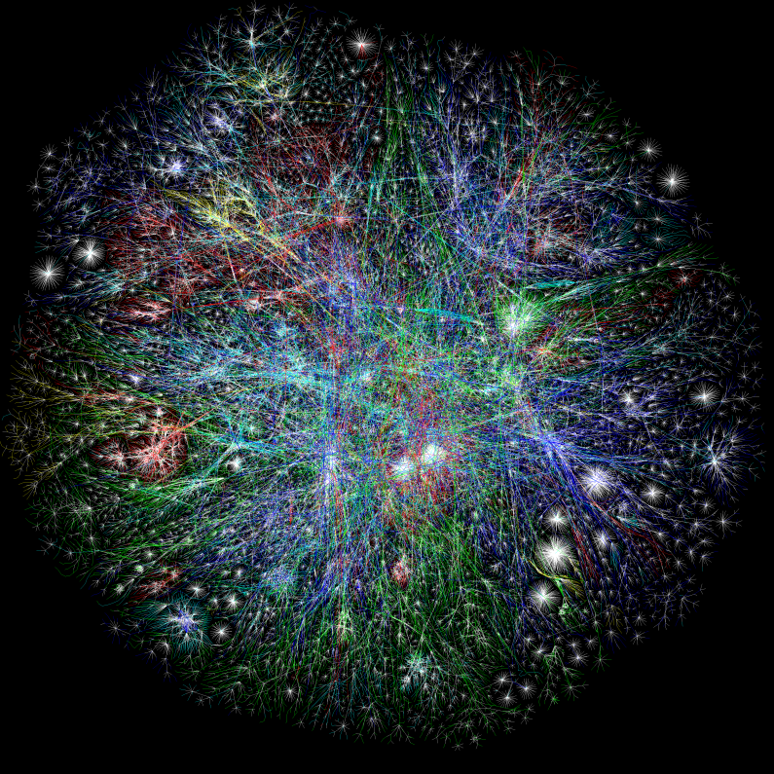
The Webs
Facebook friends graph
Internet
Notes:
Left image from Opte.org
Right image from facebook.com

Slide 10



Big Data

Slide 11


Big Computers

Slide 12
Talk Outline
Motivation
Dryad: A distributed runtime
DryadLINQ: A compiler for Dryad
Tools and applications
Sketch: A billion-row spreadsheet

Slide 13
Design Space
Grid
Internet
Data-
parallel
Sketch
Search
Dryad
Shared
memory
Data
center
Transaction
HPC
Latency
(interactive)
Throughput
(batch)
Notes:
Dryad is optimized for: throughput, data-parallel computation, in a private data-center.

Slide 14
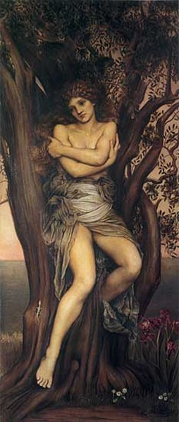
Dryad
Eurosys 2007
Continuously deployed in Microsoft since 2006
Execution engine of Bing analytics
> 10⁵ machines
Many PB of data analyzed daily
Dryad painting by Evelyn de Morgan

Slide 15
Dryad = Execution Layer
Job (application)
Pipeline
≈
Dryad
Shell
Cluster
Machine
Notes:
In the same way as the Unix shell does not understand the pipeline running on top, but manages its execution (i.e., killing processes when one exits), Dryad does not understand the job running on top.

Slide 16

2-D Piping
Unix Pipes: 1-D
grep | sed | sort | awk | perl
Dryad: 2-D
grep¹⁰⁰⁰ | sed⁵⁰⁰ | sort¹⁰⁰⁰ | awk⁵⁰⁰ | perl⁵⁰
Notes:
Dryad is a generalization of the Unix piping mechanism: instead of uni-dimensional (chain) pipelines, it provides two-dimensional pipelines. The unit is still a process connected by a point-to-point channel, but the processes are replicated.

Slide 17
Virtualized 2-D Pipelines
Notes:
This is a possible schedule of a Dryad job using 2 machines.

Slide 18


Virtualized 2-D Pipelines

Slide 19

Virtualized 2-D Pipelines

Slide 20
Virtualized 2-D Pipelines

Slide 21
Virtualized 2-D Pipelines
2D DAG
multi-machine
virtualized
Notes:
The Unix pipeline is generalized 3-ways:
2D instead of 1D
spans multiple machines
resources are virtualized: you can run the same large job on many or few machines

Slide 22
Dryad Job Structure
Channels
Input files
Stage
Output files
grep
sort
awk
sed
perl
grep
sort
sed
awk
grep
sort
Vertices (processes)
Notes:
This is the basic Dryad terminology.

Slide 23
Dryad System Architecture
data plane
Files, TCP, FIFO, Network
job schedule
V
V
V
NS, Sched
RE
RE
RE
control plane
job manager
cluster
Notes:
The brain of a Dryad job is a centralized graph manager, which maintains a complete state of the job.
The GM controls the processes running on a cluster, but never exchanges data with them.
(The data plane is completely separated from the control plane.)

Slide 24

Staging
1. Build
2. Send .exe
7. Serialize vertices
vertex code
Remote execution
service
5. Generate graph
GM code
Name server
6. Initialize vertices
3. Start manager
8. Monitor
Vertex execution
4. Query cluster resources
Notes:
Computation Staging

Slide 25
Talk Outline
Motivation
Dryad: A distributed runtime
DryadLINQ: A compiler for Dryad
Tools and applications
Sketch: A billion-row spreadsheet

Slide 26

Distributed Collections
.Net objects
Partition
Collection

Slide 27

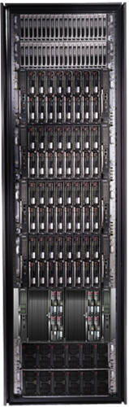
LINQ
=> DryadLINQ
Dryad
Notes:
DryadLINQ adds a wealth of features on top of plain Dryad.

Slide 28
LINQ = .Net+ Queries
Collection<T> collection;
bool IsLegal(Key);
string Hash(Key);
var results = from c in collection where IsLegal(c.key) select new { Hash(c.key), c.value};
Notes:
Language Integrated Query is an extension of .Net which allows one to write declarative computations on collections (green part).

Slide 29

DryadLINQ = LINQ + Dryad
Collection<T> collection;
bool IsLegal(Key k);
string Hash(Key);
var results = from c in collection where IsLegal(c.key) select new { Hash(c.key), c.value};
Vertex code
Query plan
(Dryad job)
Data
collection
C#
C#
C#
C#
results
Notes:
DryadLINQ translates LINQ programs into Dryad computations:
- C# and LINQ data objects become distributed partitioned files.
- LINQ queries become distributed Dryad jobs.
- C# methods become code running on the vertices of a Dryad job.

Slide 30
Language Summary
Where
Select
GroupBy
OrderBy
Aggregate
Join

Slide 31
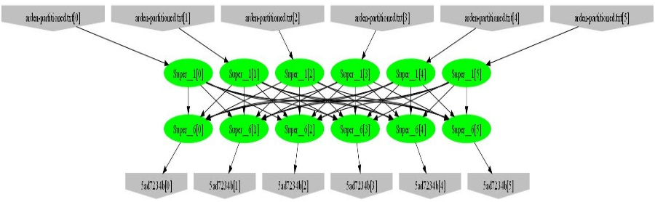
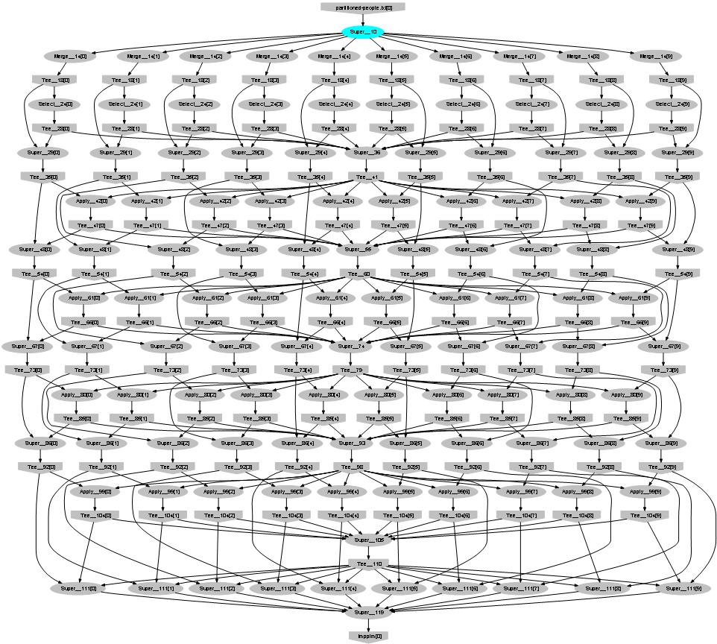
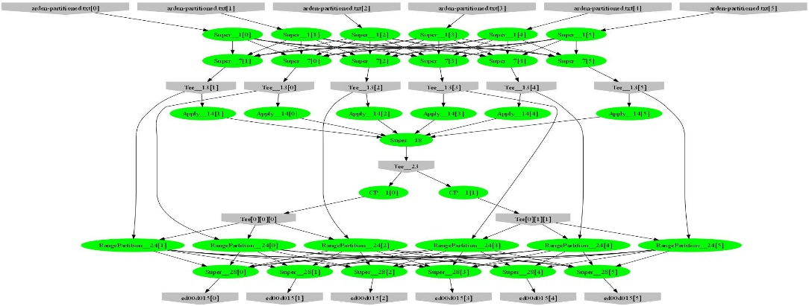
Very expressive
var result =
input.SelectMany(r => Mapper(r))
.GroupBy(r => Key(r))
.Select(g => Reducer(g));
Map-Reduce
Distributed sorting
Iterative machine-learning (EM)

Slide 32
Talk Outline
Motivation
Dryad: A distributed runtime
DryadLINQ: A compiler for Dryad
Tools and applications
Sketch: A billion-row spreadsheet

Slide 33
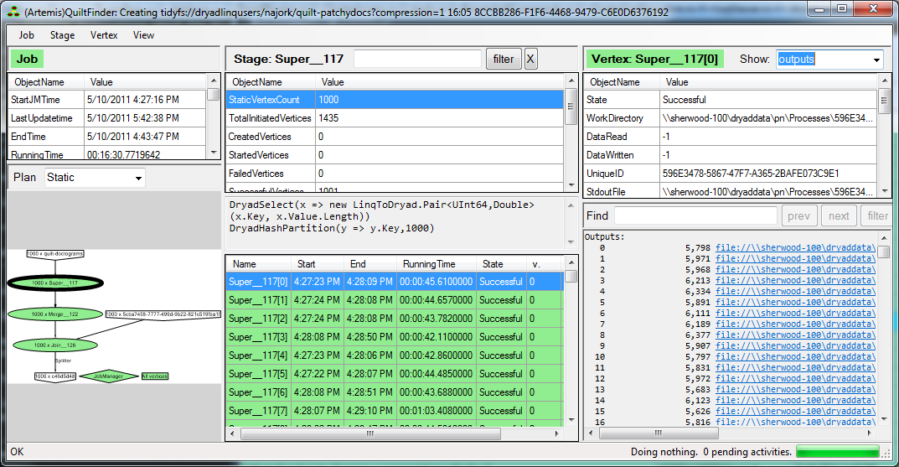
Debugging DryadLINQ jobs

Slide 34
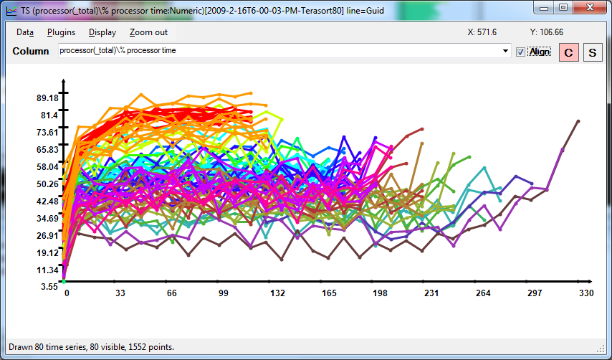
Distributed performance counters

Slide 35

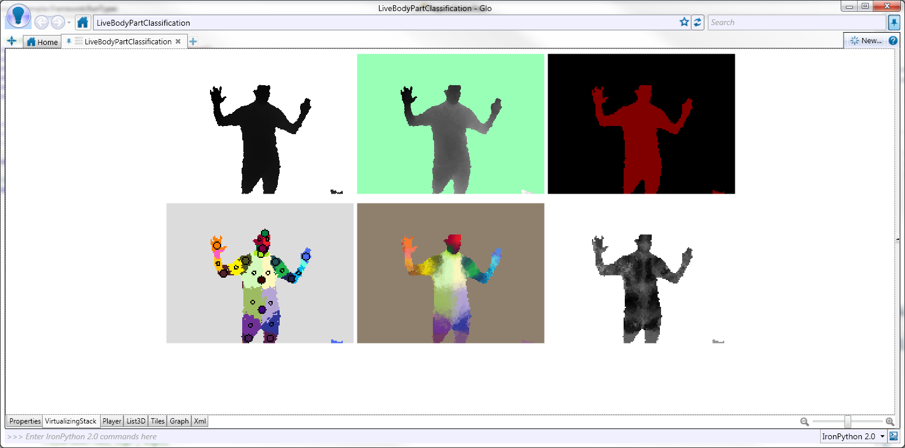
Training Kinect
Classifier
Depth map
Xbox GPU
Body parts

Slide 36
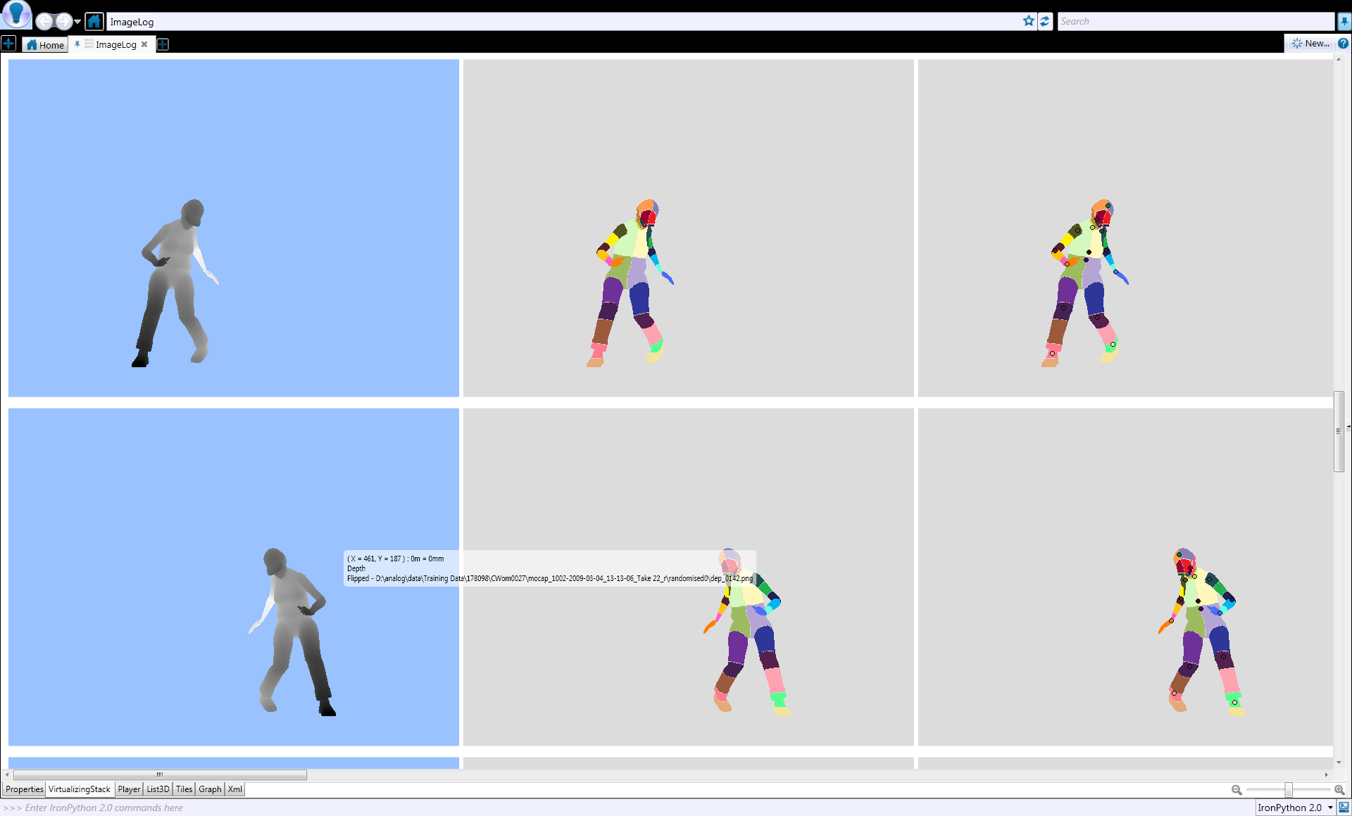
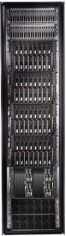

Learn from Many Examples
Decision Tree Classifier
Machine learning

Slide 37
Talk Outline
Motivation
Dryad: A distributed runtime
DryadLINQ: A compiler for Dryad
Tools and applications
Sketch: A billion-row spreadsheet

Slide 38


Bandwidth hierarchy

Slide 39

Principles
Visualizations are bounded data displays
All computations are sketches
Sketch is a runtime for
running streaming (sketching) algorithms
implementing visualizations with bounded data renderings

Slide 40

Streaming algorithms
Sketches = randomized streaming algorithms
Input = set of size n
Result same independent of the order
Memory = O(log(n))
Multi-pass
Linear input transformations

Slide 41
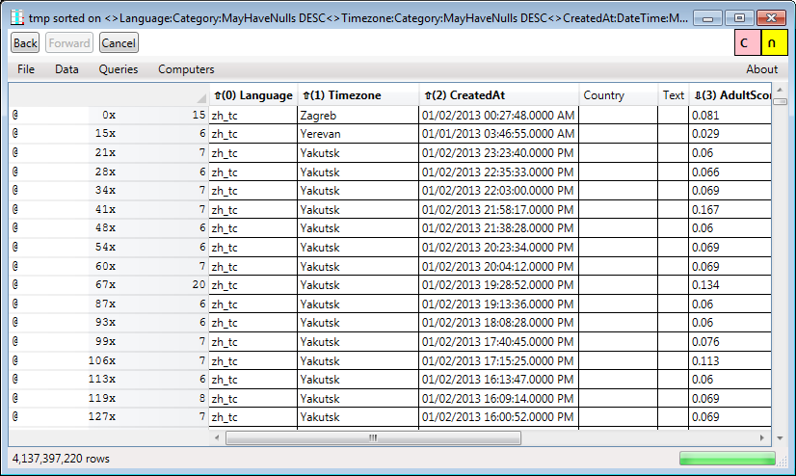
4 billion rows on 155 machines

Slide 42
Spreadsheet operations
Browsing/scrolling
Filtering
Using predicates
Heavy hitters
Sampling
Searching
Sorting
Computing new columns
Set operations (intersection, union, etc.)
Charting

Slide 43
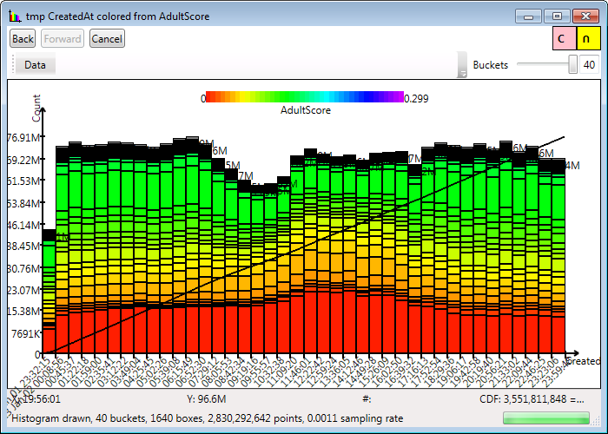
Histograms

Slide 44
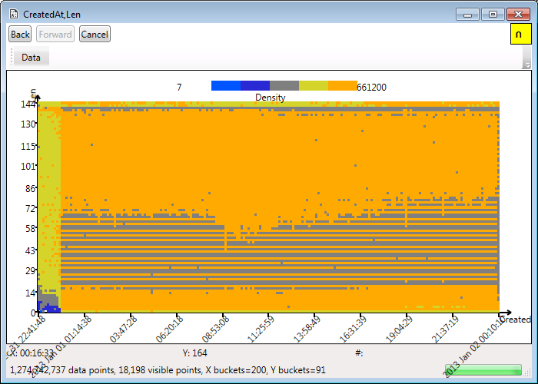
Heat Maps

Slide 45


Sketch distributed service
Sketch
service
Sketch
service
Sketch
service
Sketch
service
data
data
data
data

Slide 46
DataSets = distributed objects
Client
Application
DataSet<T>
Network
Servers
T
T
T
T
T
T
T
T
T
T
T
46

Slide 47
Sketch Spreadsheet architecture
GUI
Spreadsheet display
Table operations
Spreadsheet logic
DataSet<Table>
Distributed objects
SQL Server
CSV Files
Column store
Cosmos
Storage layer

Slide 48
DataSet API
interface IDataSet<T> { IDataSet<S> Map<S>(Func<T,S> f); IDataSet<Pair<T,S>> Zip(IDataSet<S> other); R Sketch(ISketch<T, R> sketch); }
interface ISketch<T,R> { R Create(T data); R Combine(List<R> parts); }

Slide 49
DataSet Implementations
Address space
Application
GUI
Dataset
interface
Client
Cluster parallelism
Parallel
Proxy
Proxy
RMI layer
Network
Server 0
ref
Server 1
ref
ref
Server n
Parallel
Rack aggregation
Parallel
Proxy
Parallel
Core parallelism
Parallel
Local
Local
Local
Local
Local
Local
T
T
Rack 0
T
T
T
T
Rack r

Slide 50
Map(f)
Proxy
Proxy
Parallel
Parallel
Local
Local
Local
Local
T
T
S
S
f
f

Slide 51
Sketch(s)
interface ISketch<T,R> { R Create(T data); R Combine(List<R> parts); }
R
Proxy
s.Combine
R
Parallel
R
R
Local
Local
s.Create
T
T

Slide 52
Zip
Proxy
Proxy
Proxy
Parallel
Parallel
Parallel
Local
Local
Local
Local
Local
Local
T
T
S
S
T,S
T,S

Slide 53
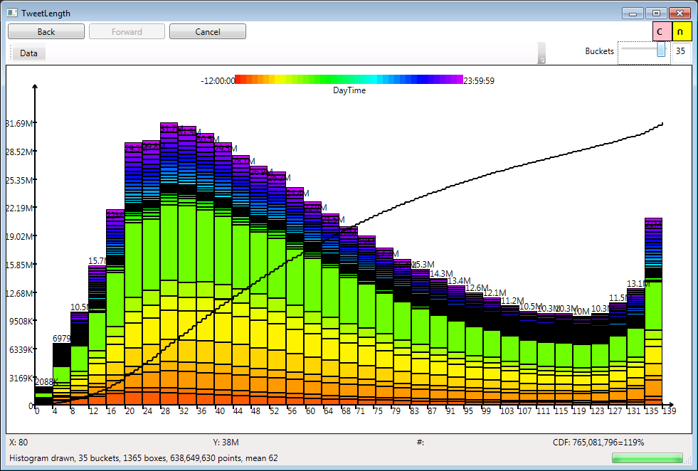
Histograms
CDF
2D
histogram

Slide 54
Computing a histogram
User click
t_{a}
Display
histogram
Render
t_{r}
t_{h}
Client
Histogram
1D + 2D
composite
sketch
Data range
sketch
Server 1
Server n
Compute

Slide 55
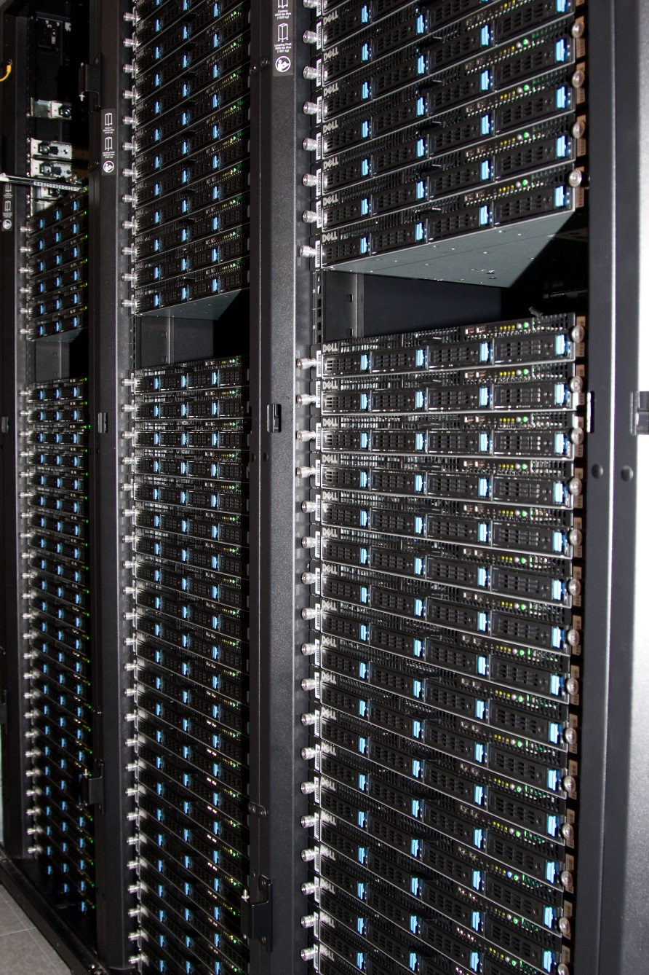
Some numbers
Window Server 2012 R2
8-core 2.1GHz AMD Opteron 2373 EE
> 16GB RAM
3 x 1TB disks using RAID-0
155 machines
5 racks
1Gbps Ethernet

Slide 56
Null Sketch
Time (ms)
Machines

Slide 57
Histogram computation
26M rows/machine
Scale-out
Time (ms)
machines

Slide 58

Conclusions
Big data is here to stay
Better tools are needed
Quest for high-level abstractions for building distributed systems
Execution graphs
Distributed collections
Higher-order transformations
Distributed stateful objects
Sketching algorithms

Slide 60
Data-Parallel Computation
Application
Sawzall, Java
≈SQL
LINQ, SQL
Sawzall,FlumeJava
Pig, Hive
DryadLINQ Scope
Language
Map-Reduce
Hadoop
Dryad
Execution
GFS BigTable
HDFS
S3
Cosmos
Azure SQL Server
Storage

